Slide 1
SigMoid
Impacting the World

Slide 2

OUR STORY…
As young, hungry individuals growing up in South Africa, we see a lot of social injustices and environmental changes.
Notes:
We started our journey at Explore Data Science discovering new innovative ways in which technology could impact on society. As young, hungry individuals growing up in South Africa we see a lot of social injustices and environmental changes. One day whilst leaving home to go to Explore, I saw a thriving informal business take shape. A makeshift scooter carrier designed to load up recyclable material from household goods and containers for perishables was moving by. Five minutes later, another one. Clearly a group of individuals had decided to create change and opportunity for themselves by seeking to better the environment and also profit from it. They were impacting the world.

Slide 3

OUR STORY…
A group of individuals had decided to create change and opportunity for themselves by seeking to better the environment.
They were impacting the world…
Notes:
We started our journey at Explore Data Science discovering new innovative ways in which technology could impact on society. As young, hungry individuals growing up in South Africa we see a lot of social injustices and environmental changes. One day whilst leaving home to go to Explore, I saw a thriving informal business take shape. A makeshift scooter carrier designed to load up recyclable material from household goods and containers for perishables was moving by. Five minutes later, another one. Clearly a group of individuals had decided to create change and opportunity for themselves by seeking to better the environment and also profit from it. They were impacting the world.

Slide 4
THE COMPANY
A Data Analytics company focussed on analysing and predicting human sentiment regarding social and environmental issues using machine learning
Notes:
Inspired by these change creators, a group of us at Explore looked for ways to impact the world using technology. Enter Sigmoid. A Data Analytics company focussed on analysing and predicting human sentiment regarding social and environmental issues to assist companies in aligning their brand, business interests and investments with impactful social change using machine learning.

Slide 5
PROBLEMS
Depletion of fossil fuel sources
Unsustainable agricultural practices
Global warming
Poor health and healthcare

Slide 6
IMPACT INVESTING
Investments with the intention to generate positive, measurable social and environmental impact alongside financial return
$719 Billion industry by 2019
Assists in diversifying investments
Pursue market competitive returns by investing in untapped markets for future income generation

Slide 7
SIGMOLUTION
Understand
social and environmental challenges by analysing and predicting sentiment from social media posts.
Quantify
this sentiment to gear your brand towards impactful change.
Help
your business understand impact investing.

Slide 8
TAKE ADVANTAGE OF
A pool of capital from the capital markets geared towards impact investments.
Government incentives and tax credits
The opportunity to assist your brand in becoming more socially conscious while generating positive interest and good public relations.

Slide 9
VALUE PROPOSITION
Modelling sentiment allows you to define a market and areas to enter that market.
Position yourself in low income markets where there could be a greater potential for growth.
Internal communications within your business to measure your carbon footprint via analysing employee sentiment towards environmental factors.
Align your brand with socially conscious movements, gain customers, and increase customer retention.

Slide 10
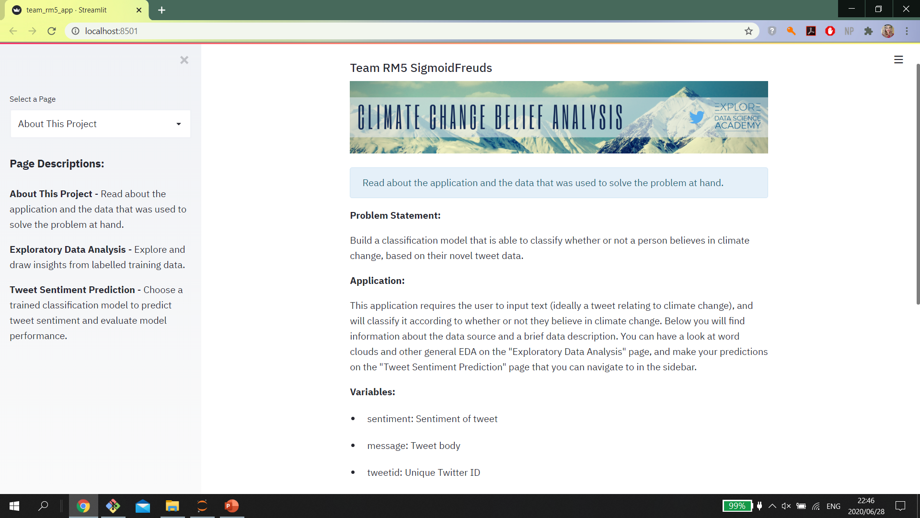
STREAMLIT
WEB APP
Predict tweet sentiments and explore data insights with our user-friendly app
Place your screenshot here

Slide 13
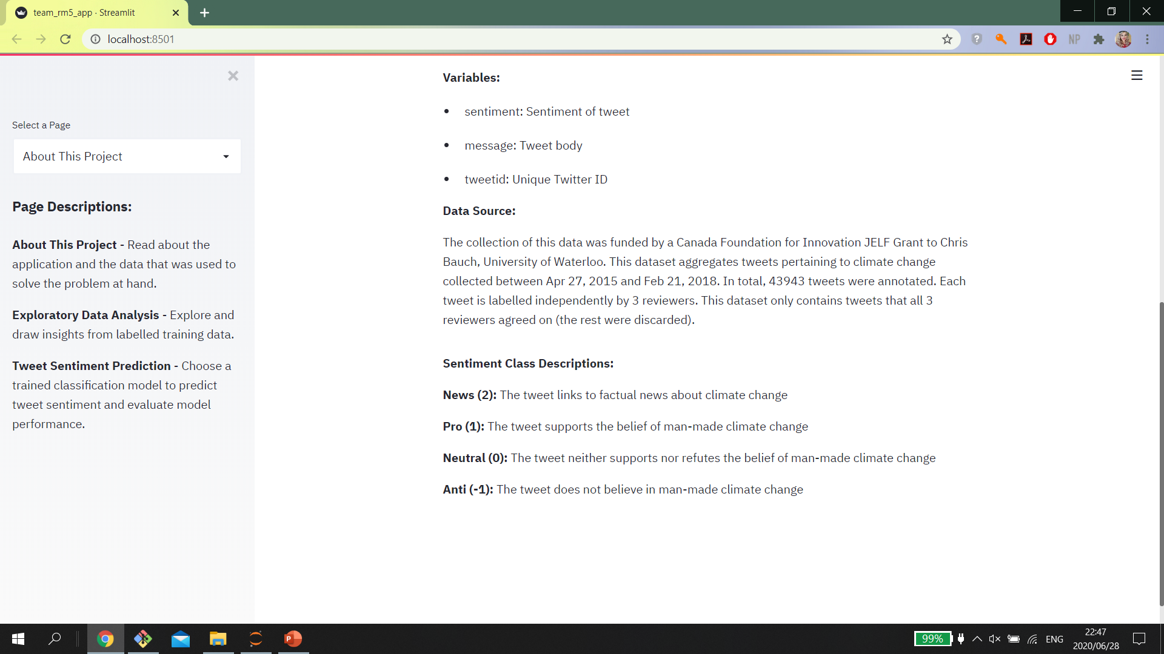

Slide 14
EXPLORATORY DATA ANALYSIS
Insights From Model Training Data
Notes:
Inspired by these change creators, a group of us at Explore looked for ways to impact the world using technology. Enter Sigmoid. A Data Analytics company focussed on analysing and predicting human sentiment regarding social and environmental issues to assist companies in aligning their brand, business interests and investments with impactful social change using machine learning.

Slide 15
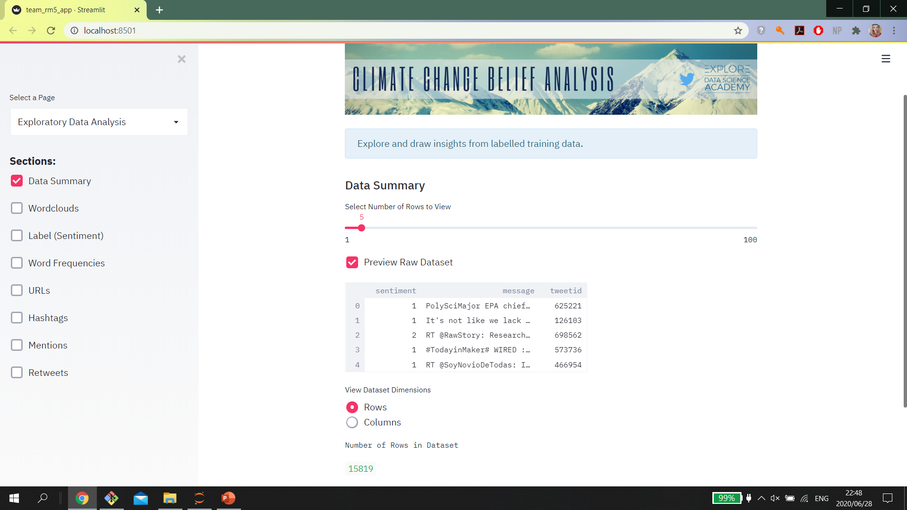

Slide 16
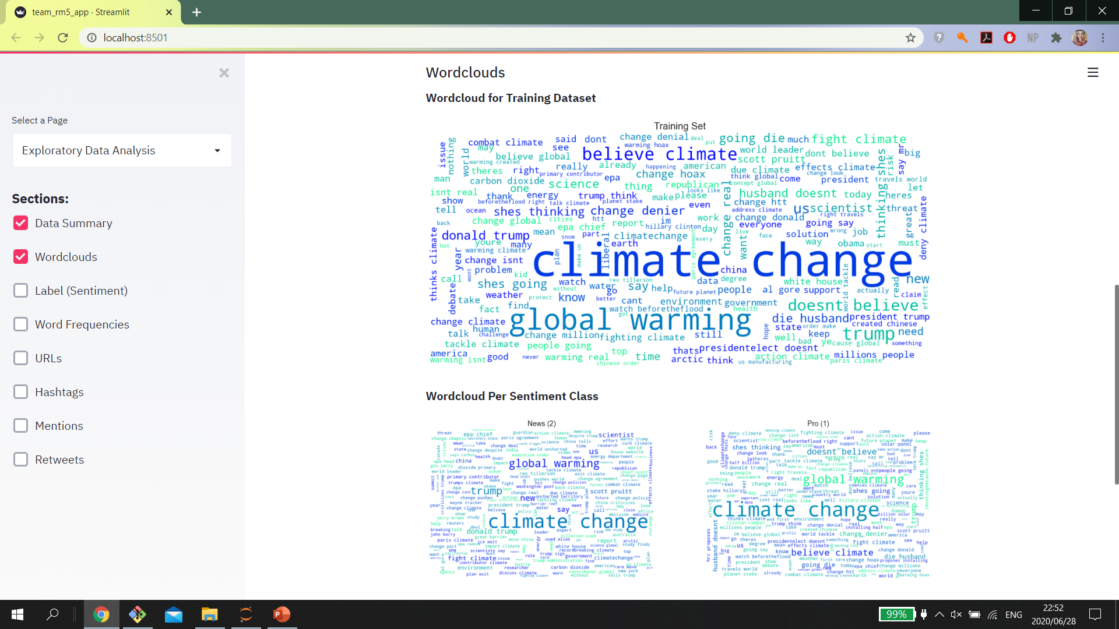

Slide 17
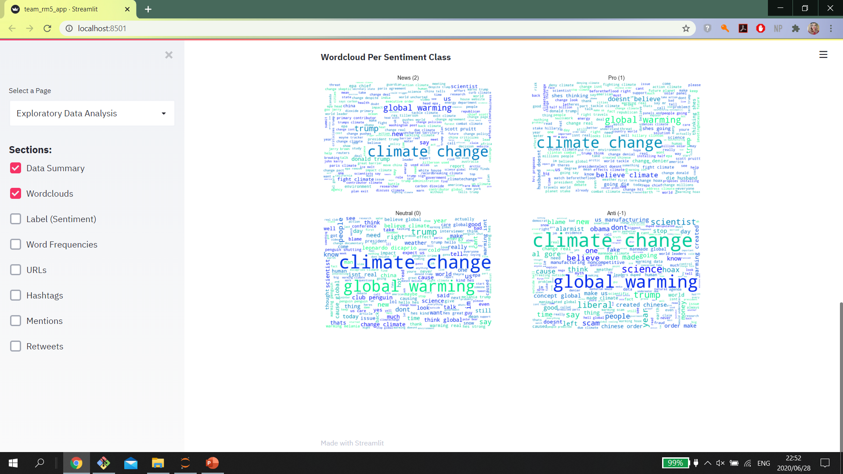

Slide 18
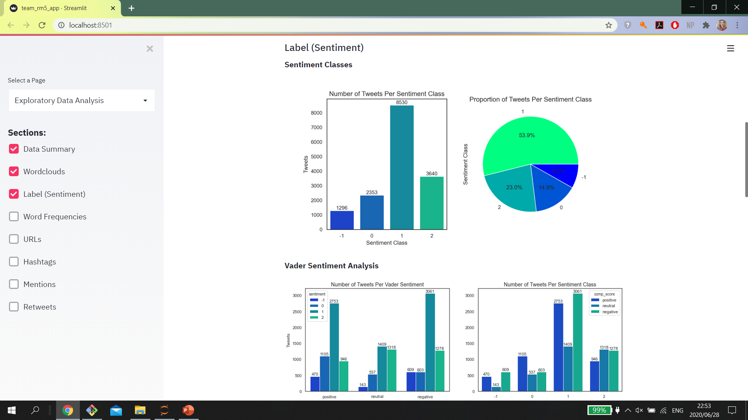

Slide 19
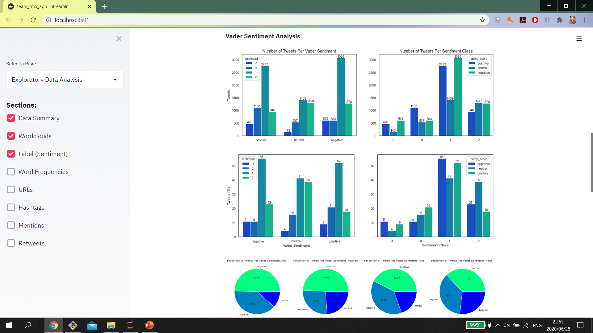

Slide 20
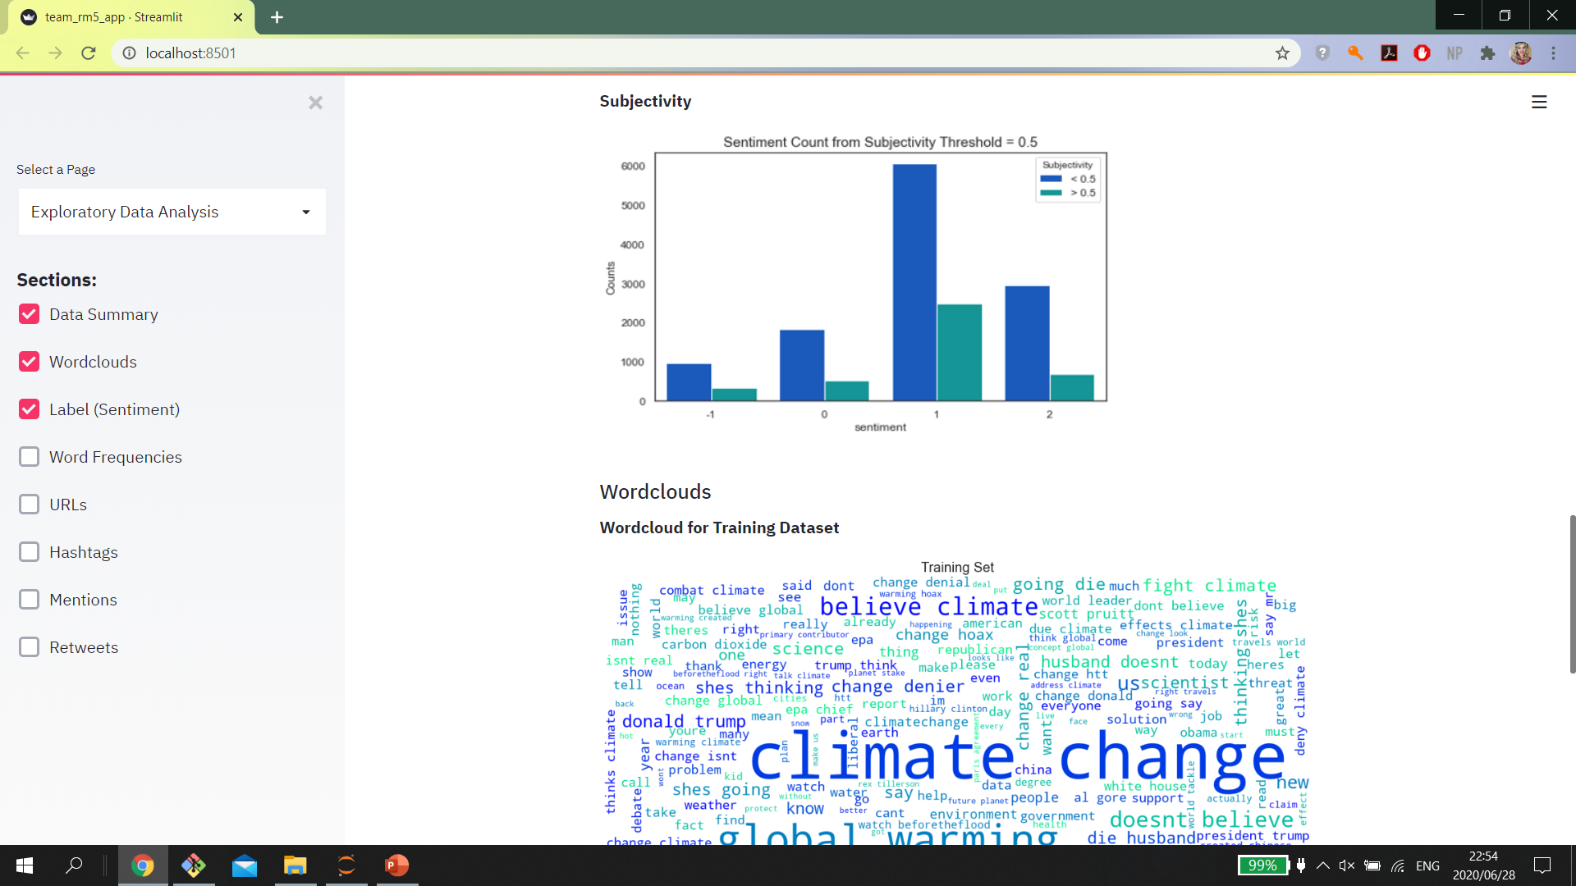

Slide 21
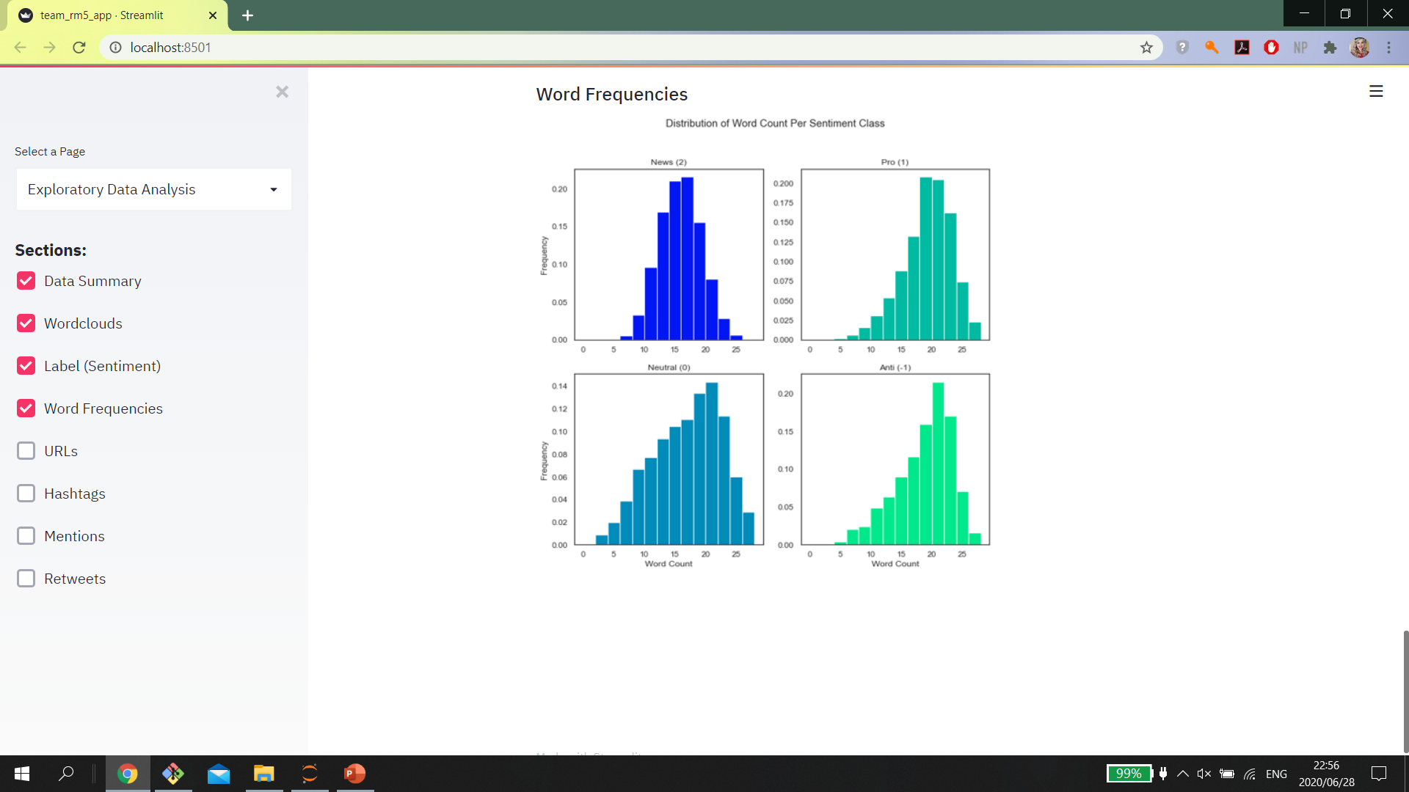

Slide 22
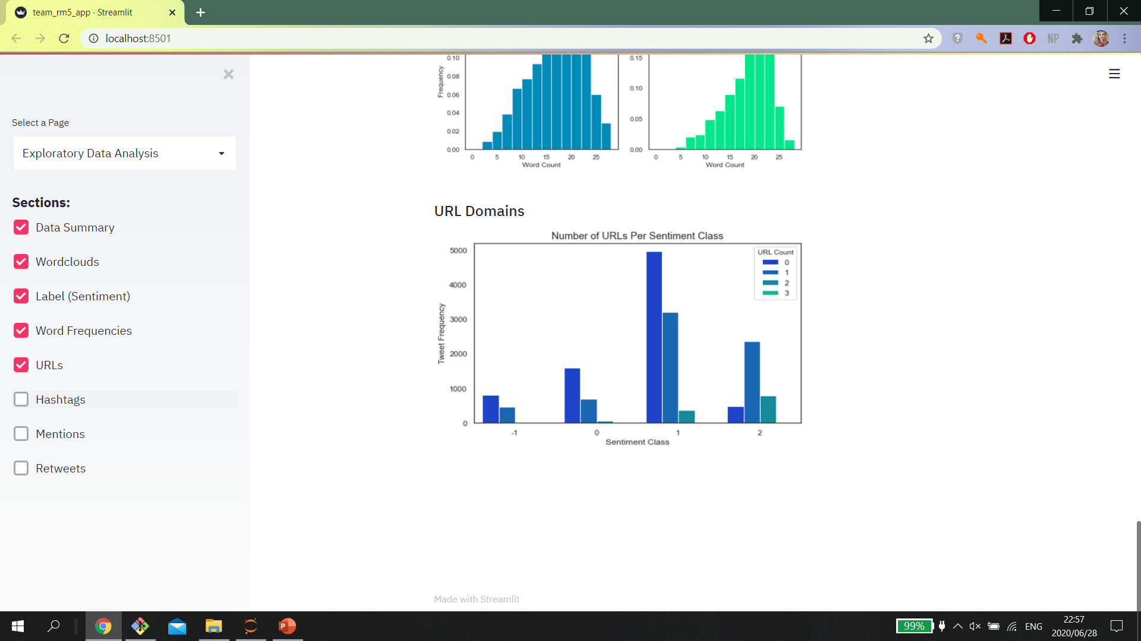
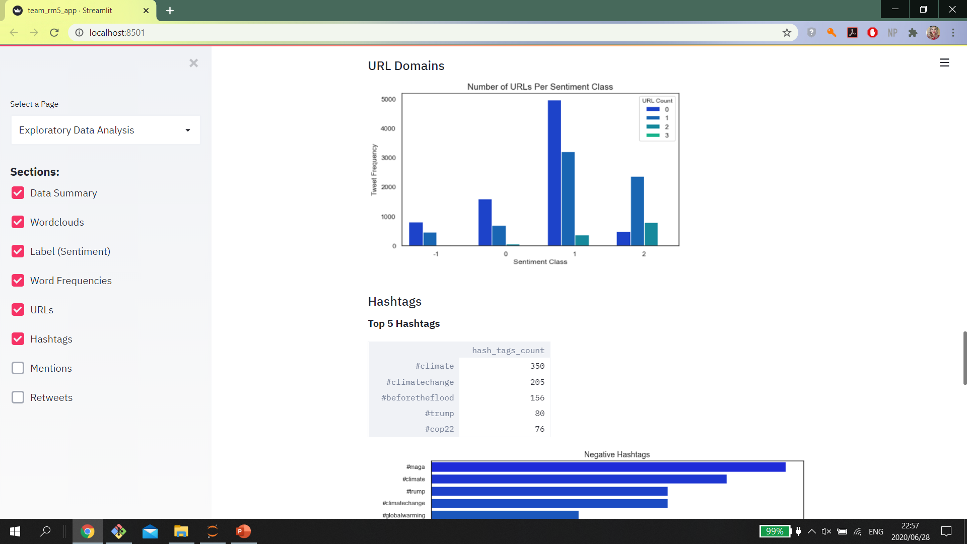

Slide 23
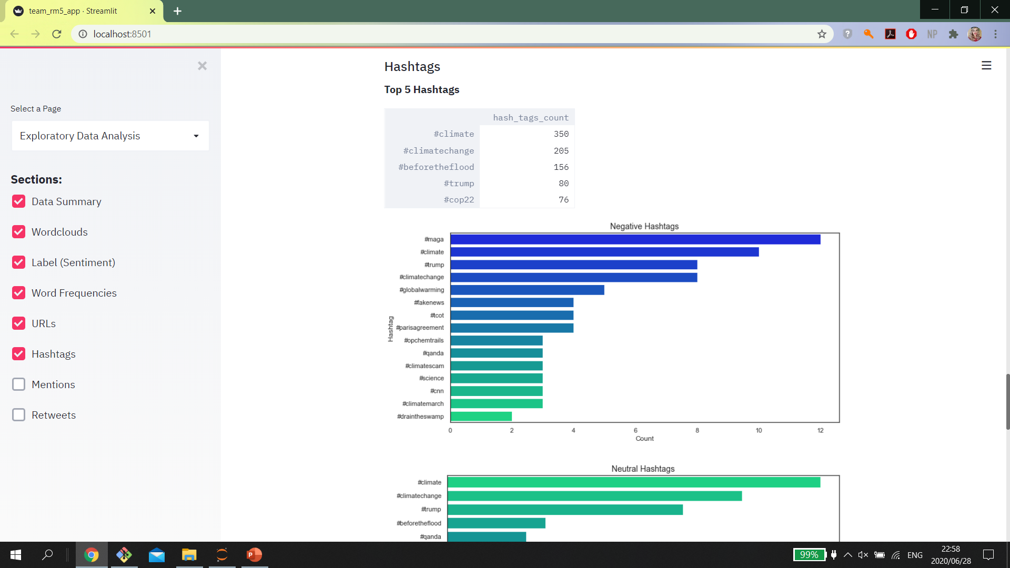

Slide 24
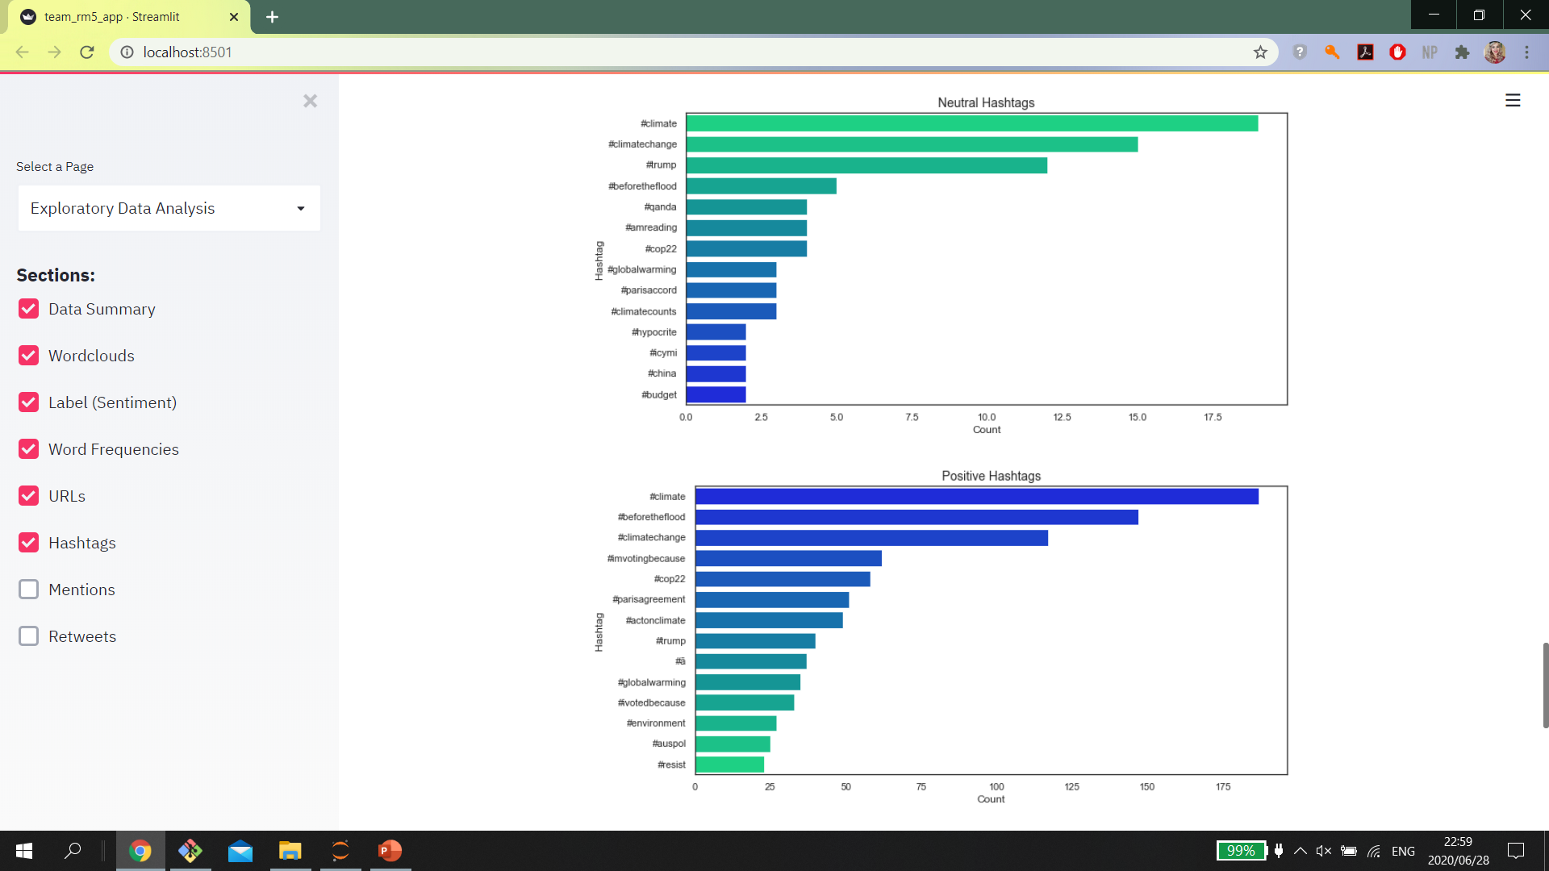

Slide 25
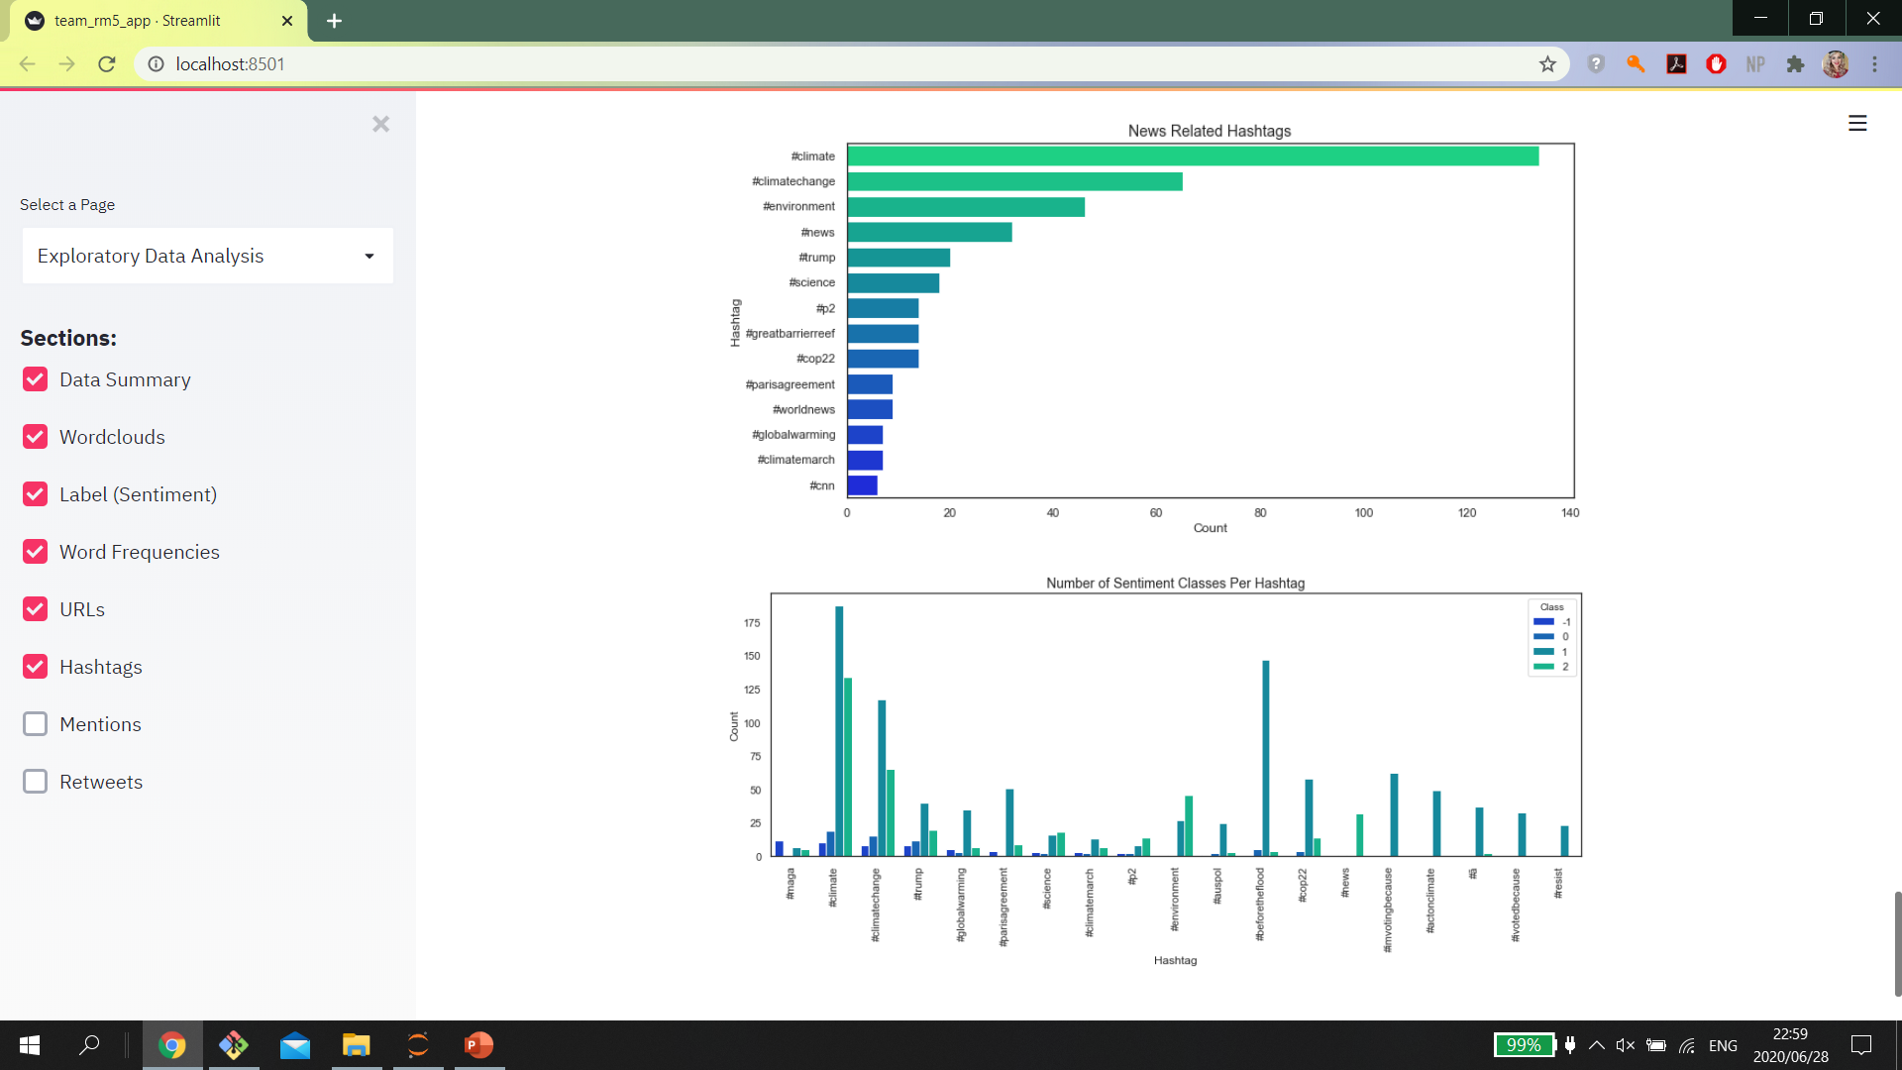

Slide 26
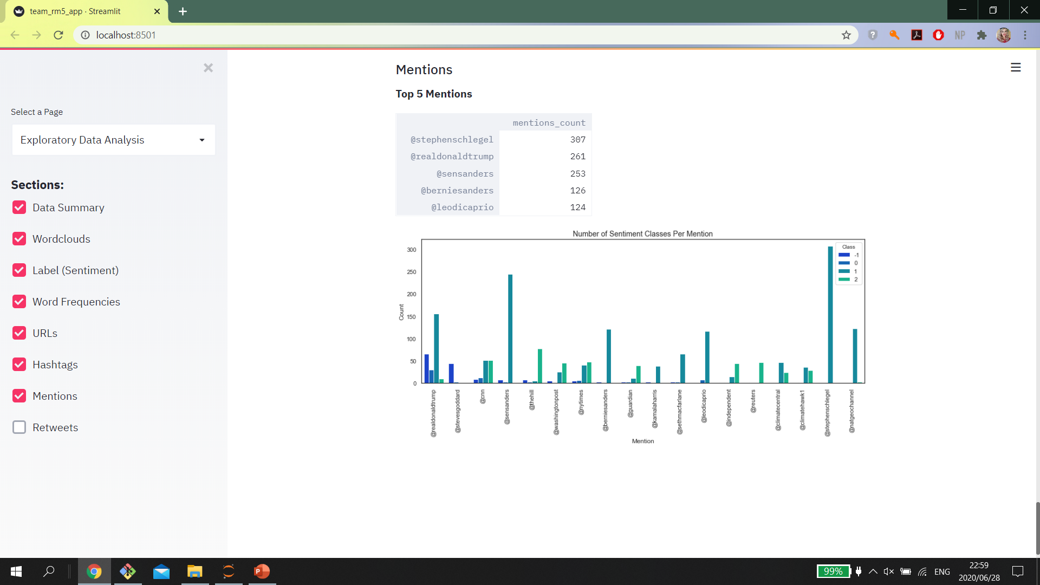

Slide 27
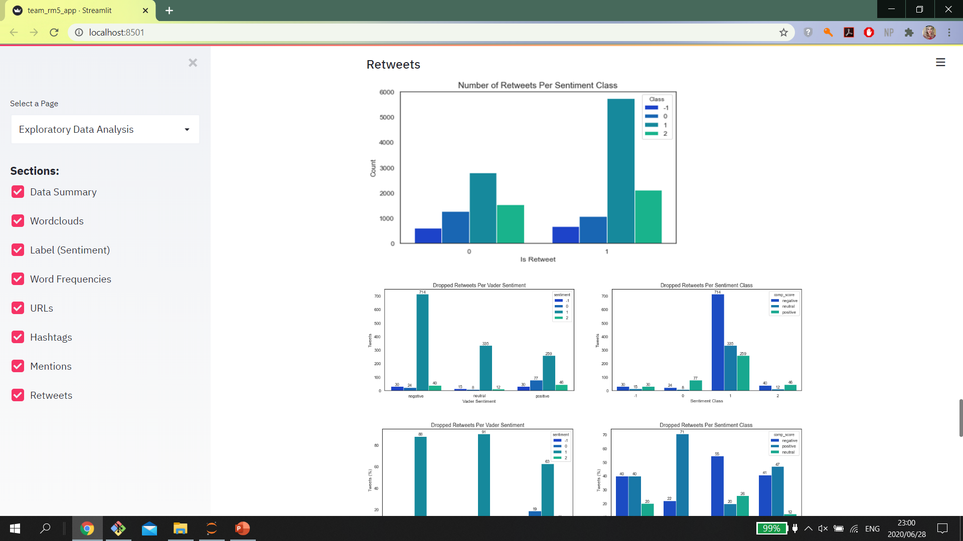

Slide 28
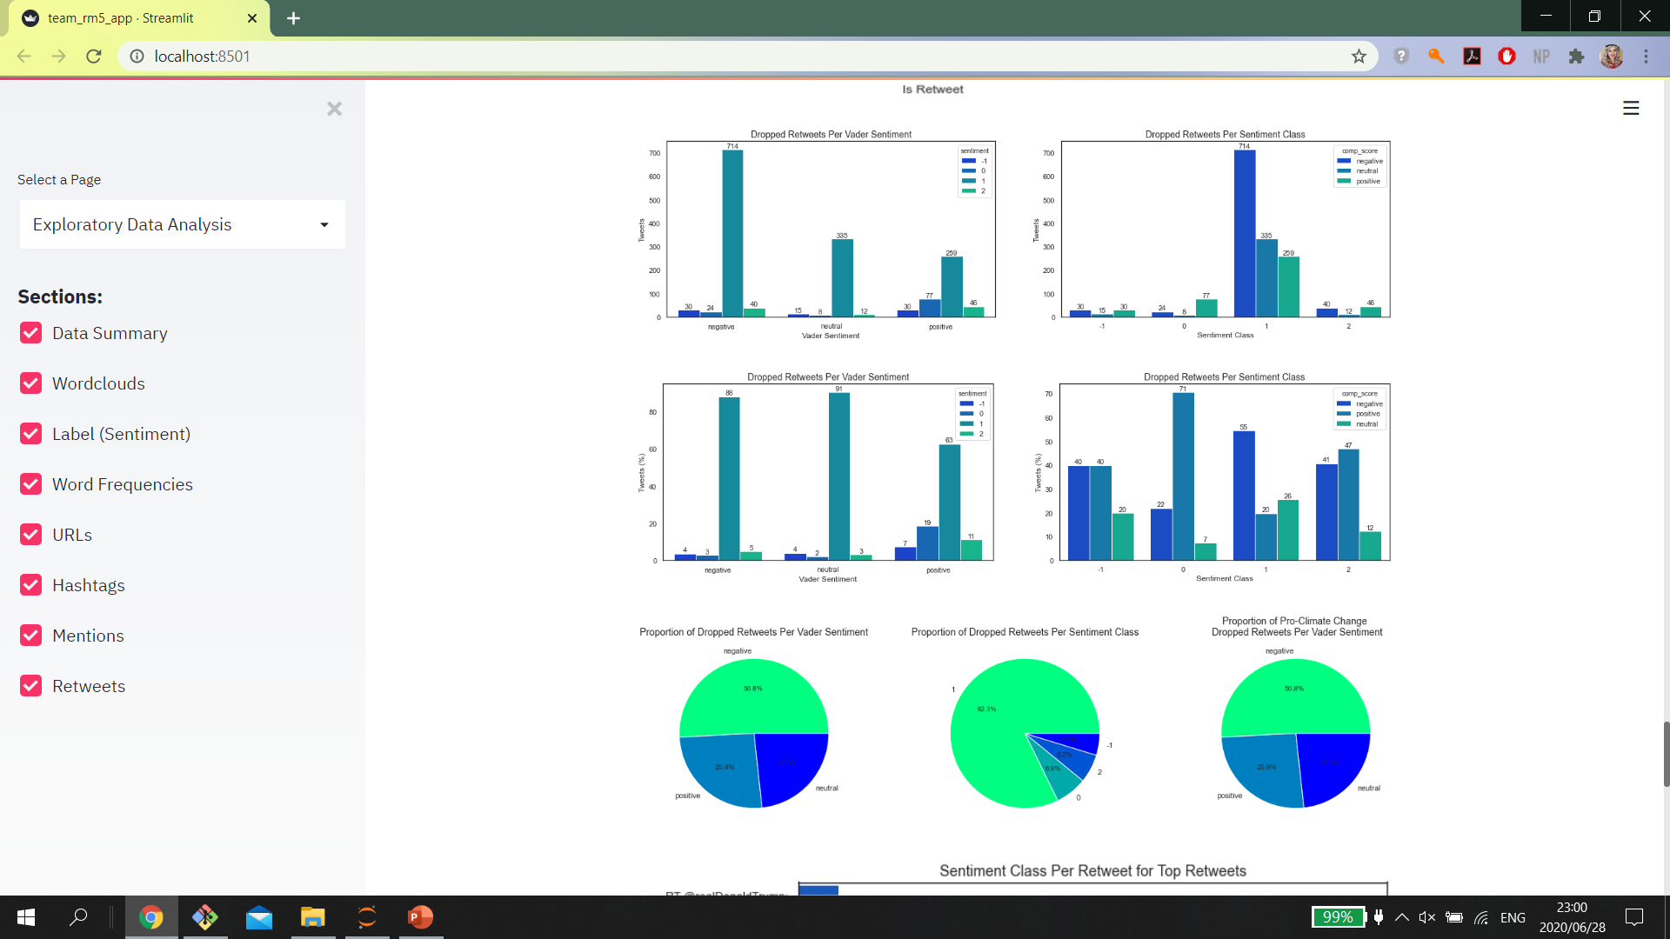

Slide 29
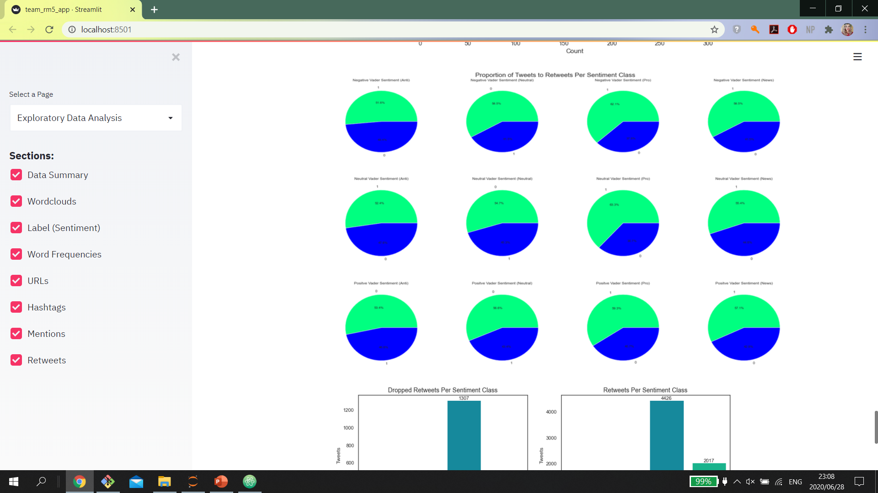

Slide 30
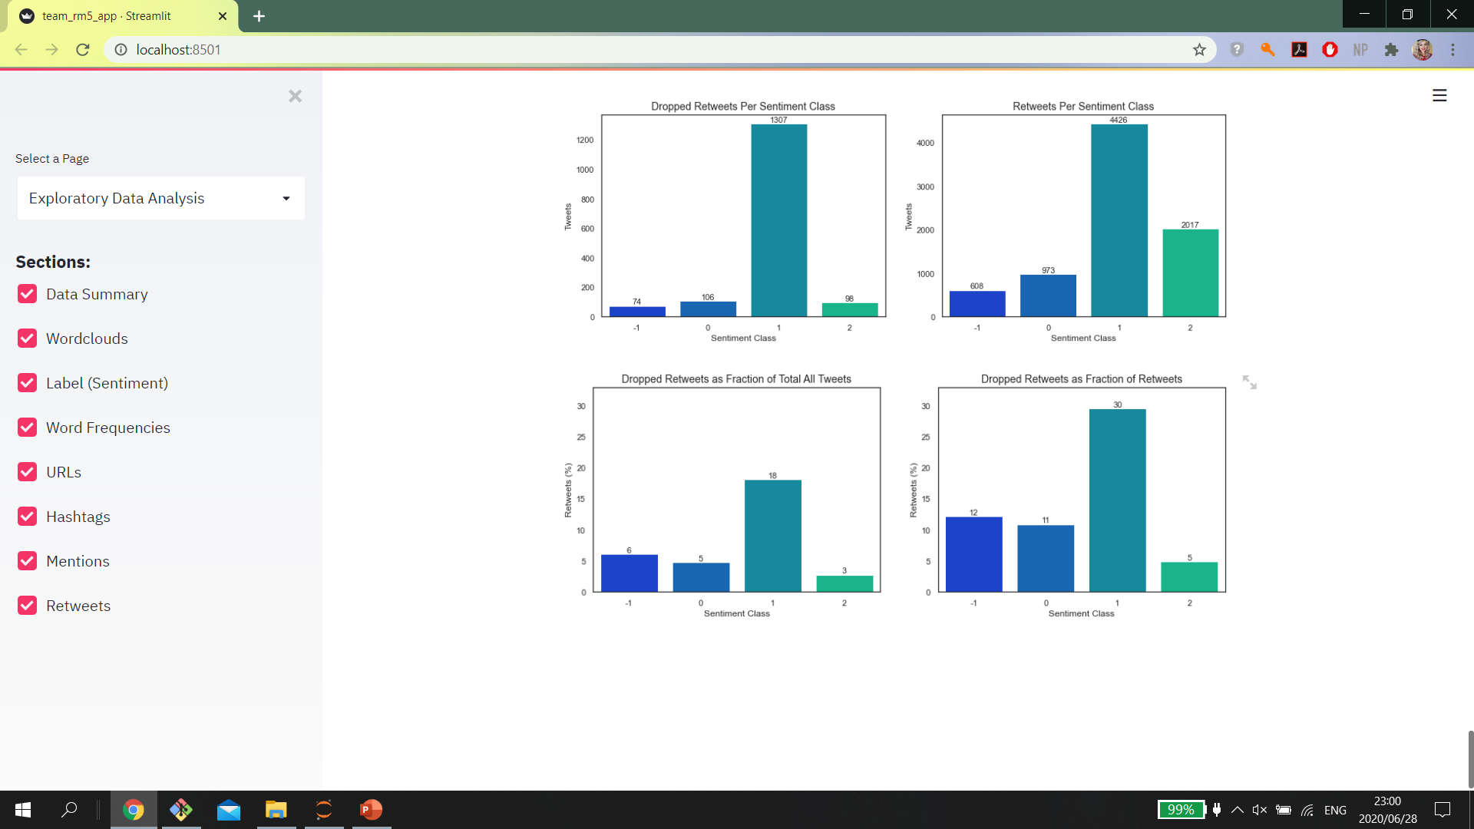

Slide 31
TWEET SENTIMENT PREDICTION
Apply Trained Classification Models To Predict Tweet Sentiment
Notes:
Inspired by these change creators, a group of us at Explore looked for ways to impact the world using technology. Enter Sigmoid. A Data Analytics company focussed on analysing and predicting human sentiment regarding social and environmental issues to assist companies in aligning their brand, business interests and investments with impactful social change using machine learning.

Slide 32
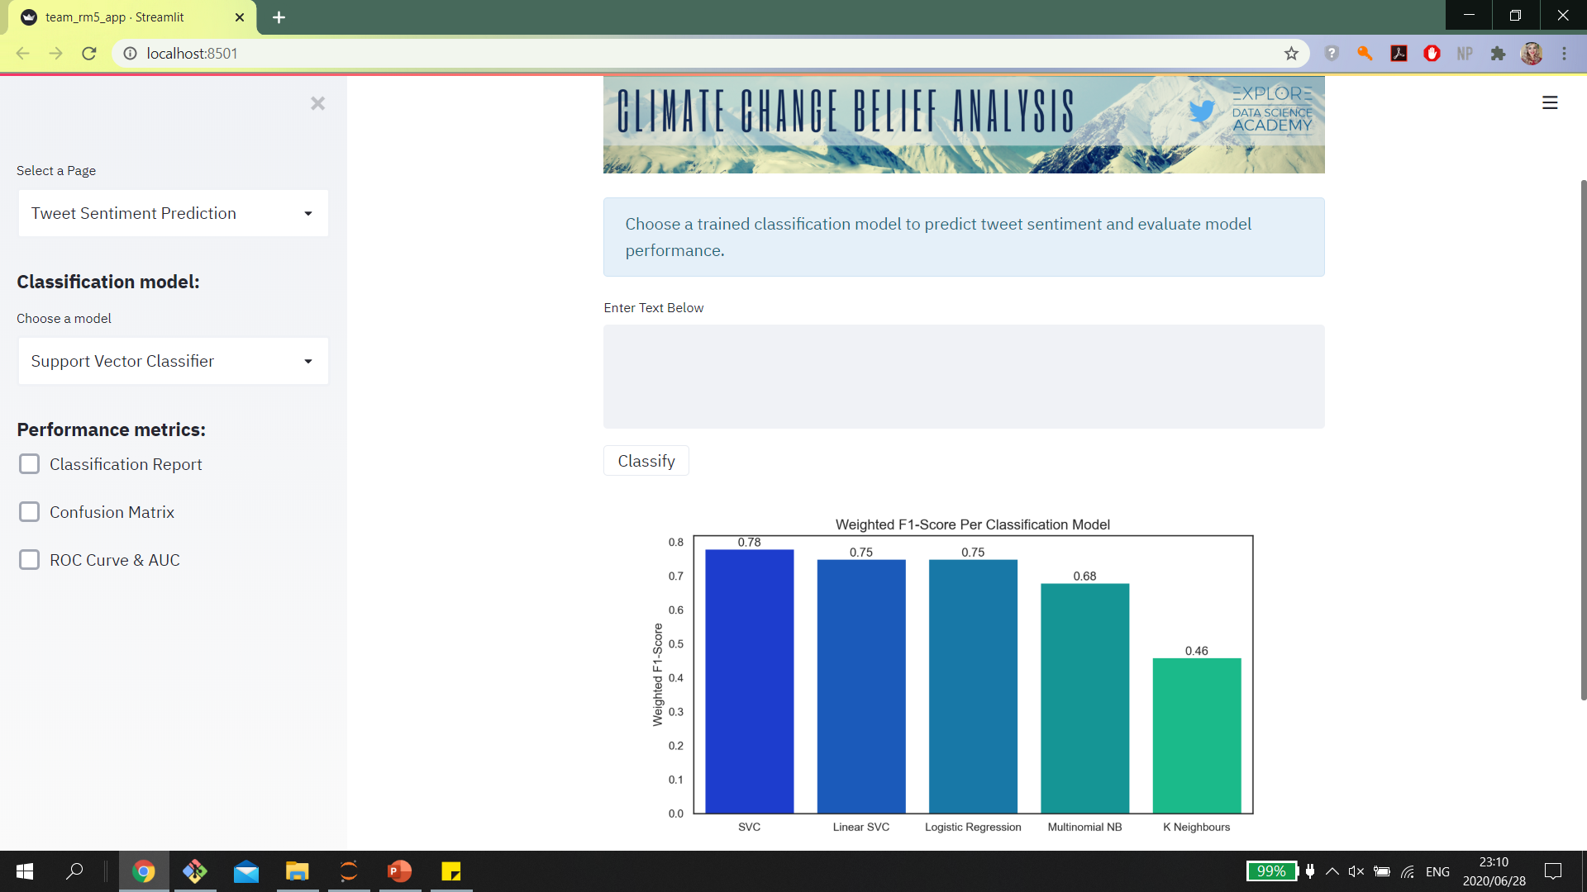

Slide 33


Slide 34
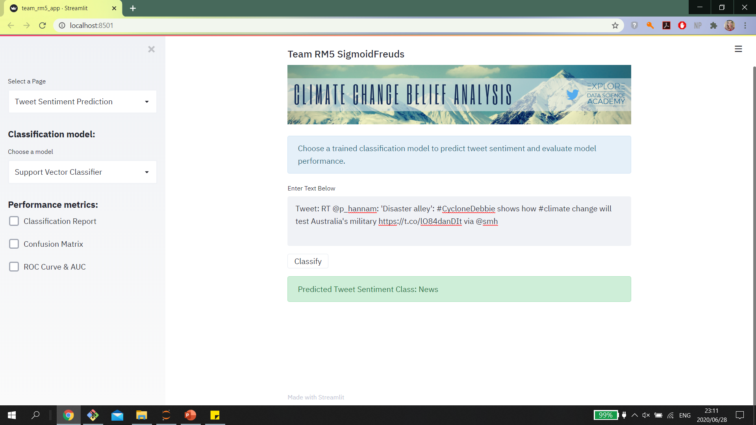

Slide 35
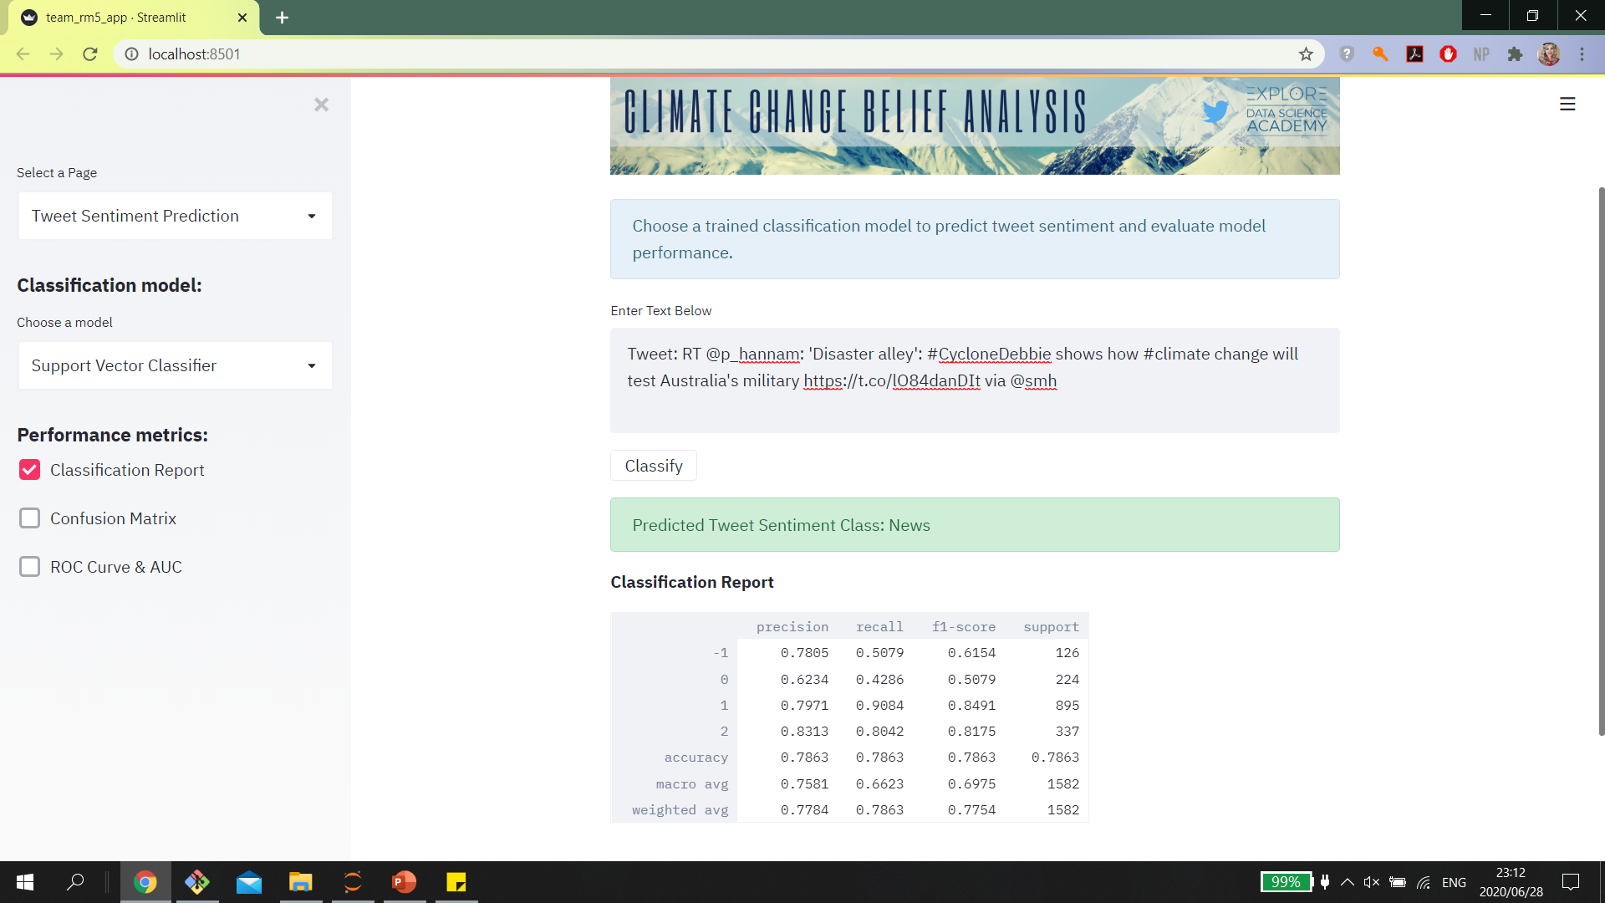

Slide 36
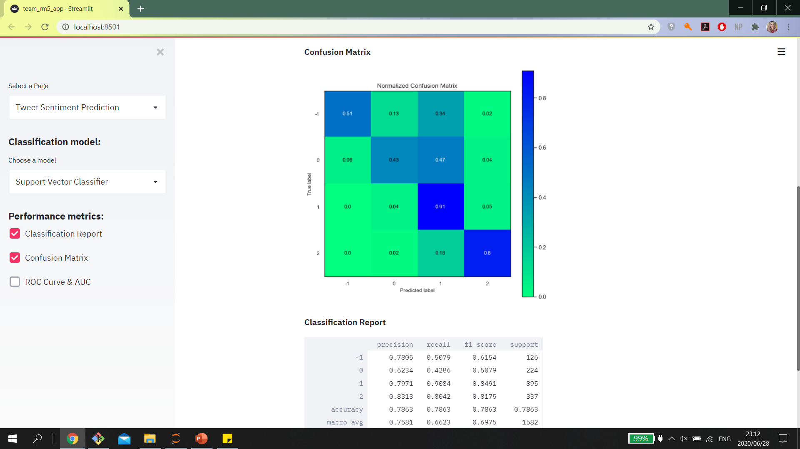

Slide 37
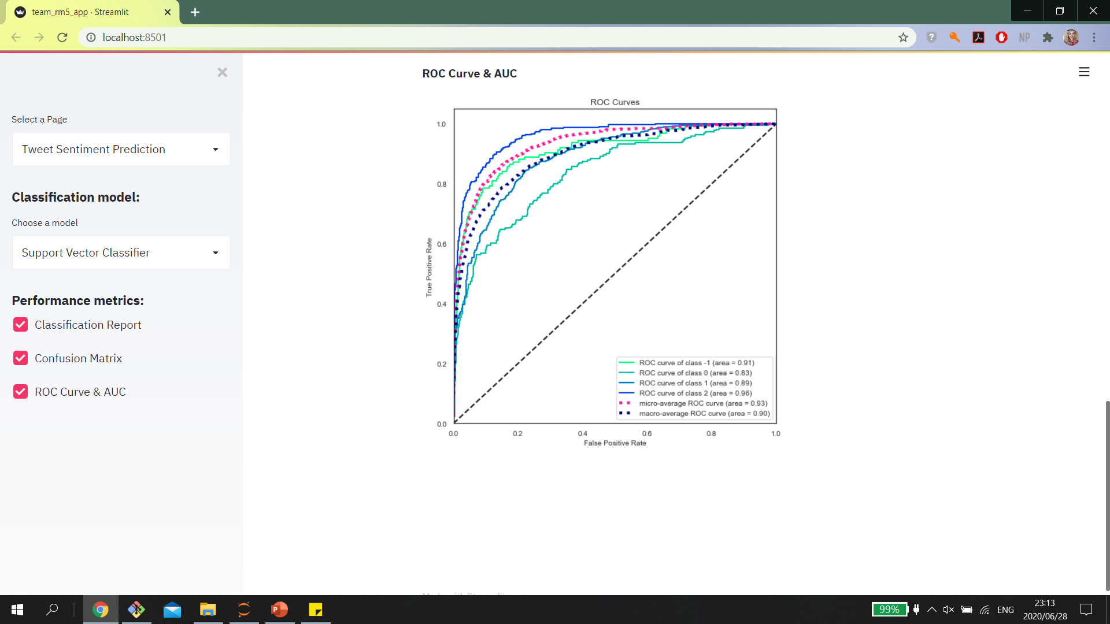

Slide 38
COMET
Experiment Logs
Notes:
Inspired by these change creators, a group of us at Explore looked for ways to impact the world using technology. Enter Sigmoid. A Data Analytics company focussed on analysing and predicting human sentiment regarding social and environmental issues to assist companies in aligning their brand, business interests and investments with impactful social change using machine learning.

Slide 39
